Slide 1

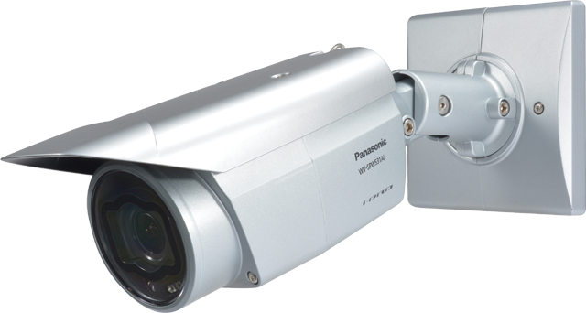

Outdoor Fixed Network Camera
WV-SPW531AL / WV-SPW311AL
Security Systems Business Division
Panasonic System Networks Co., Ltd.

Slide 2
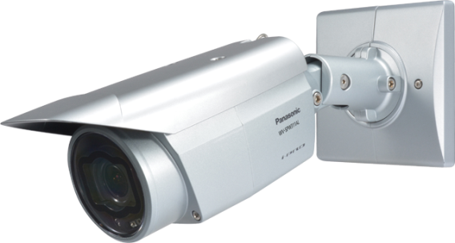
Outdoor Fixed Network Camera
2
WV-SPW531AL (1080p, 60fps)
WV-SPW311AL (720p, 60fps)
Super Dynamic Fixed Network camera
  Outdoor-ready with integrated IR
  Clear images in a wide range of lighting conditions
  Full HD/HD at up to 60fps
  IP-Network friendly
  Optional intelligent VMD (i-VMD)

Slide 3
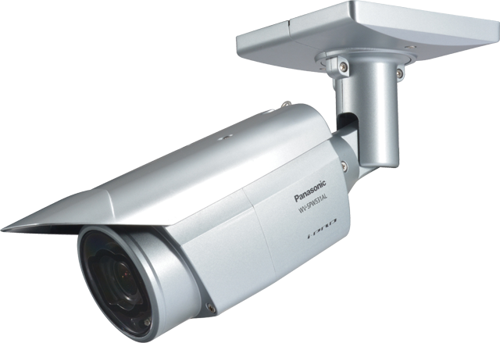
Outdoor-ready with integrated IR
3
Built-in IR illumination
Infrared (IR) illumination is an option for low light or complete darkness conditions. The WV-SPW531AL/SPW311AL outdoor cameras are equipped with built-in long range IR LEDs which illuminate around 30m (100feet).
Quick and Easy Installation
The IP66- and NEMA 4X-rated weather-resistant WV-SPW531AL/SPW311AL outdoor cameras are ready for mounting outdoor and save installation time and costs.
The built-in dehumidification unit keeps the cameras in good running order for many years by removing moisture from inside the housing.
Wall mount
Ceiling mount

Slide 4
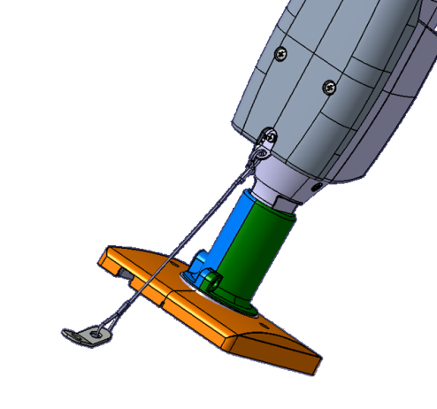
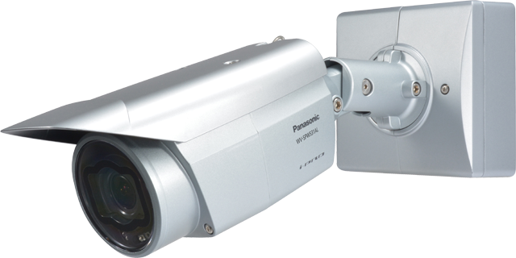
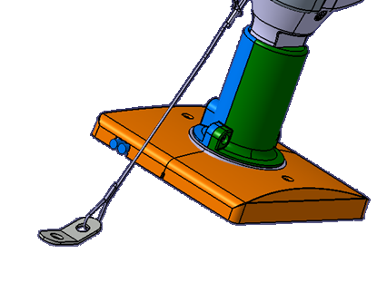
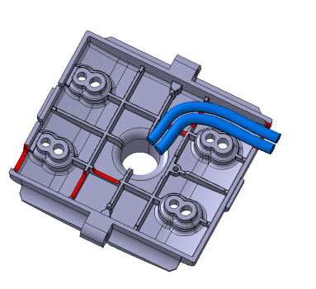
Outdoor-ready with integrated IR
4
Easy mounting
The WV-SPW531AL/311AL can be mounted directly on the wall.
You can choice the installation with the base bracket (“WV-Q120A”) or without it. When using WV-Q120A, you can store the extra cables. *WV-Q120A is the optional accessary.
LAN Cable and I/O cable out of this hole.
with WV-Q120A
without WV-Q120A

Slide 5
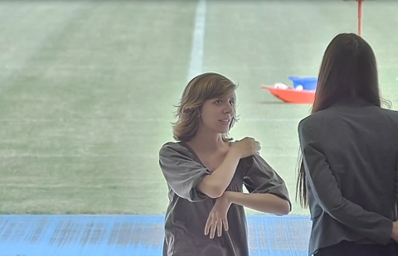
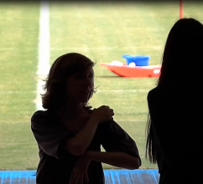
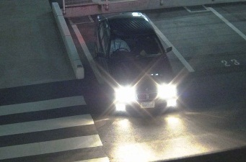


Clear images
5
Clear images in a wide range of Lighting conditions
Even a single image can include complex lighting conditions such as bright, glaring, dark and backlight situations. Incorporating advanced image processing technologies, WV-SPW531AL/SPW311AL camera enables clear and easy identification in a wide range of lighting conditions.
-Enhanced Super Dynamic
-Multi-process Noise Reduction (MNR)
-Frequency Divided Filter (FDF)
-Super Chroma Compensation (SCC)
-Fog and sandstorm compensation
-High Light Compensation (HLC) and more…
Full HD / HD at up to 60fps
Combining Full HD 1080p / HD 720p resolution and 60fps high frame rate, WV-SPW531AL/SPW311AL fixed camera enables easy and clear identification of rapid moving objects such as people moving chips and cards in casino, and a vehicle plate on the road.

Slide 6
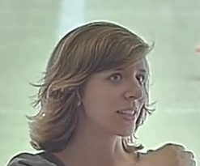
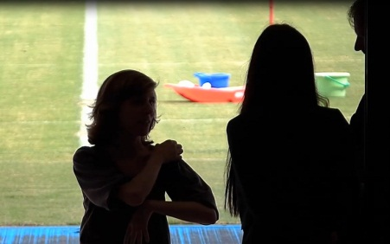
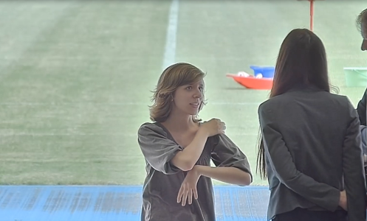
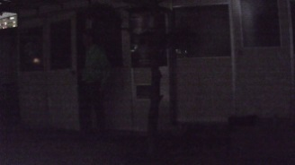
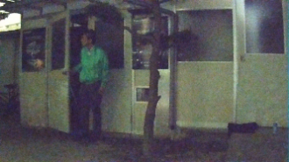

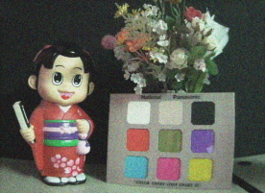
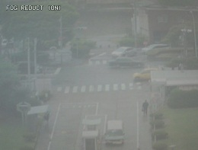
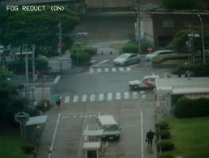
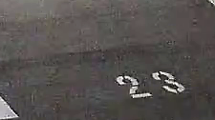
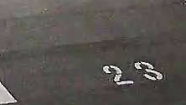
Panasonic image processing technologies
6
Enhanced Super Dynamic delivers an industrial leading 133dB wide dynamic range. With variable exposure and shutter speed control, Enhanced Super Dynamic captures multiple images with optimal short and long exposures. Enhanced Super Dynamic produces clear images, combining them into one frame.
High sensitivity image sensor with 3D-MNR enables easy identification, capturing color images with low noise in low light conditions.
3D-MNR: 3D Multi process Noise Reduction.
A previous model at 0.04lx
5-series camera
at 0.04lx
Without Enhanced Super Dynamic
With Enhanced Super Dynamic
Frequency Divided Filter (FDF) divides the images into multiple frequency ranges, removes the fine noise generated under low illumination for achieving a low bit rate without eliminating edge components.
Super Chroma Compensation
(SCC) recovers the colors of images, when built-in IR cut filter is removed to enhance light-sensitivity in low light conditions.
Fog compensation improves visibility in difficult weather conditions such as fog, sandstorms and more.
Without SCC
With SCC
Without fog compensation
With fog compensation
Without FDF
With FDF

Slide 7
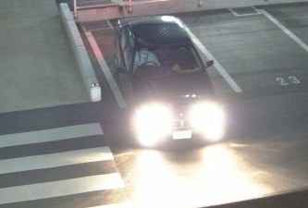
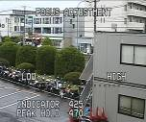


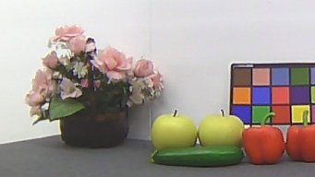
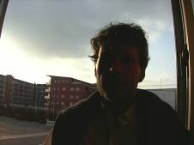

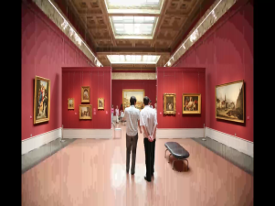


Panasonic image processing technologies
7
High Light Compensation (HLC)
produces clear images, reducing the effect from strong lights such as headlight glare.
High-speed Auto Back Focus (ABF) keeps fine focus, controlling precise image sensor position automatically. It streamlines installation and maintenance works.
Lens Distortion Compensation
(LDC) removes the distortion from images caused by wider lens.
Without HLC
With HLC
Before ABF
After ABF
Without LDC
With LDC
Intelligent Resolution Technology
generates 3M-pixel grade pictures, detecting outlines, detailed texture areas and soft gradation areas and performing optimum processes to each area. (WV-SPW531AL)
Face Super Dynamic enables clear identification of a person’s face, detecting a facial part in the picture and performing Super Dynamic automatically.
Variable Image Quality on Specified area (VIQS) saves the network bandwidth and recorder disk space, capturing clear images of region of interest with higher image quality.
Lower image quality
Higher image quality to region of interest
Without intelligent resolution technology
With intelligent resolution technology
Without Face Super Dynamic
With Face Super Dynamic

Slide 8
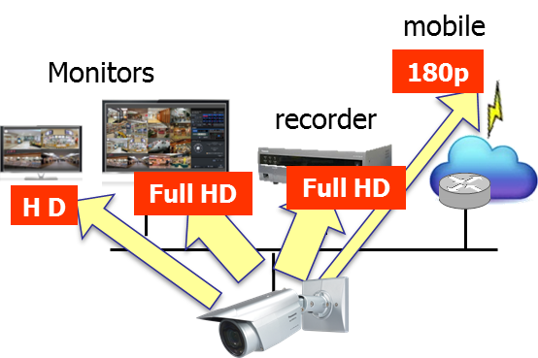
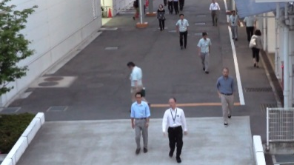
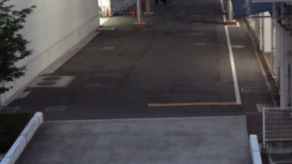
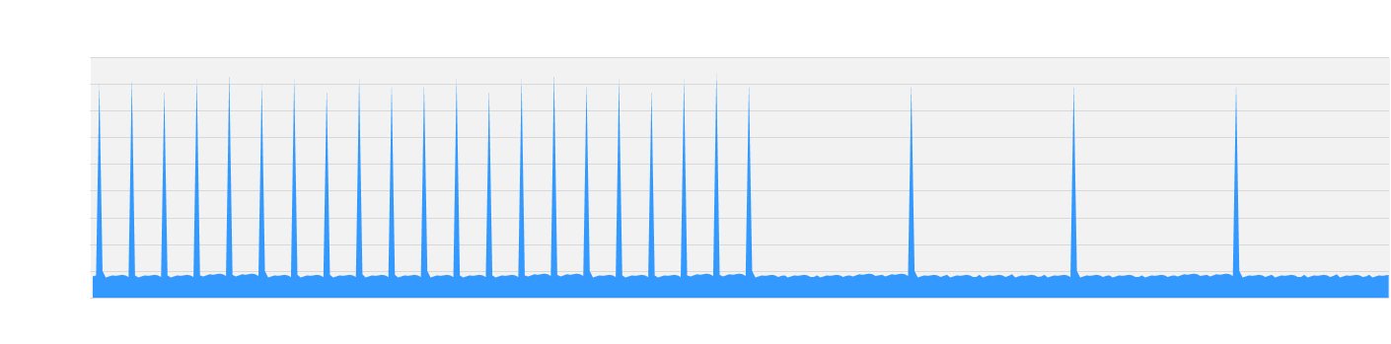
IP-Network friendly
8
Appropriate-sized video stream
Monitors, recorders, smartphones and remote sites such as branches have different requirements for image quality and network bandwidth. WV-SPW531AL/SPW311AL camera saves the network bandwidth, sending out up to four H.264 (High profile) streams and JPEG streams sized appropriately for each device requirement.
Higher H.264 compression
With the latest UniPhier system LSI, WV-SPW531AL/SPW311AL camera saves the network bandwidth and the recorder disk space, keeping high quality of images.
Smart coding Technology
Group of Pictures (GOP) control removes unnecessary information from the frame for realizing efficient encoding.
With the latest bitrate reducing technology, GOP control, 3D-MNR and FDF, WV-SPW531AL/SPW311AL camera saves the network bandwidth and the recorder disk space.
Cameras | WV-SP509 | WV-SPW531AL
Full HD at 30fps | 4 Mbps | 3 Mbps ( -25%)
Full HD at 10fps | 4 Mbps | 2 Mbps ( -50%)
Scene | Without GOP | With GOP
Heavy traffic of people | 3 Mbps | 3 Mbps
Minimal traffic of people | 2 Mbps | 1 Mbps(-50%)
Generated
code amount
Predicted
Frame
Predicted
Frame
Predicted
Frame
When people are walking, I-frame is inserted at regular intervals as usual.
When there is no person walking, I-frames are thinned down to reduce the amount of data.

Slide 9
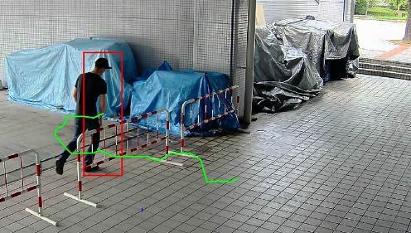
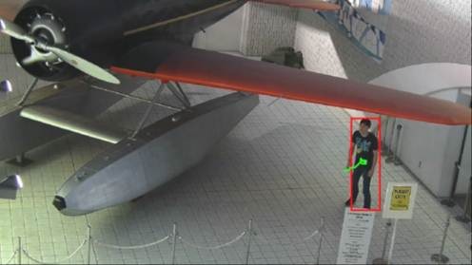
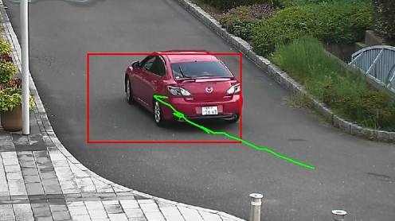
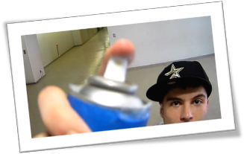
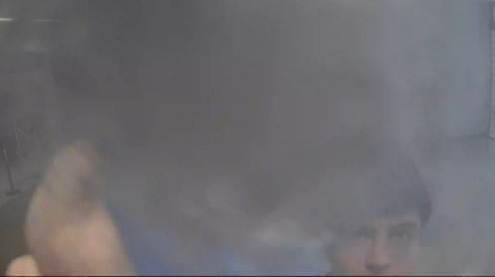
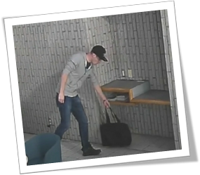
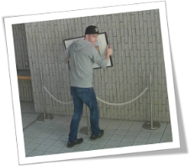
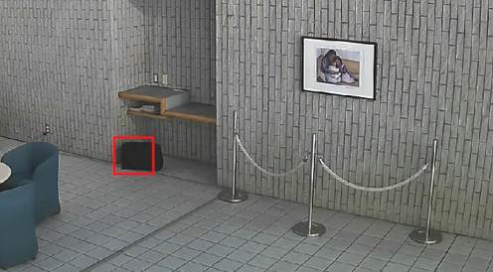
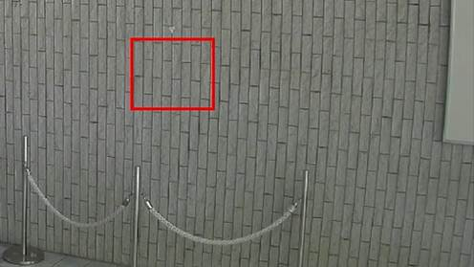
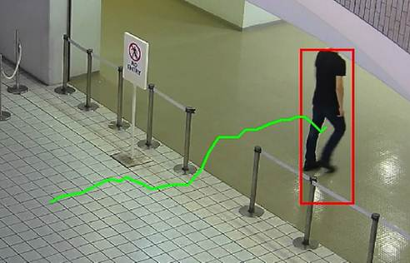
Optional intelligent VMD (i-VMD)
9
Higher accuracy with more intelligence
Equipped with advanced self-learning algorithm and the latest powerful UniPhier system LSI, WV-SPW531AL/SPW311AL camera provides high detection accuracy.
Intruder detection
detects people or cars trespassing in restricted areas.
Loitering detection
detects people who has loitered for too long in the area.
Direction detection
detects people or cars that go the wrong direction.
Scene change detection detects tampering with the camera view.
Object detection (left)
detects something left behind that shouldn’t be there.
Object detection (removed)
detects objects disappearing that should be present.
Cross line detection
detects people or objects crossing the imaginary lines.

Slide 10
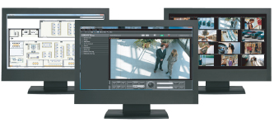
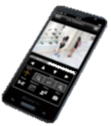
… and other useful features
10
Secure SD memory recording
Equipped with a SD memory card slot, WV-SPW531AL/SPW311AL camera stores recordings locally. Recordings can be password-protected and alteration detection helps ensure credibility of data.
Central management
The WV-ASM200 and System970 i-PRO management software enables central management of the cameras, recorders and monitors.
Viewing on smartphones and tablets
Panasonic Security Viewer enables viewing outside the surveillance center.
View and Setting with various browsers
When the camera is configured and checked, it does not have to be a specific browser such as only IE. Various browsers (Safari, Chrome*, Firefox and IE) can be used.
*The live display is supported only JPEG.
Alarm notification
When VMD, i-VMD, terminal alarm such as door alarm or command alarm is detected, the camera sends alarms to the operators based on pre-configured alert rule and/or saves images to the SD memory card or FTP server.
Privacy masking
The camera supports electronic privacy masking. Zones, the masked areas of the image, are easily defined.

Slide 11
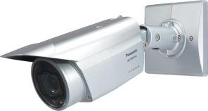

Specifications
11
 |  | WV-SPW531AL | WV-SPW311AL
Appearance
Type |  | Outdoor
Image sensor |  | 1/3 type MOS Sensor
Max. resolution |  | 2,048 x 1,536 | 1,920 x 1,080^{*1} / 1,280 x 960 *1:Super resolution technology
Max. frame rate |  | 60 fps
Day / Night |  | Yes (IR Cut filter Removal)
Focus Adjustment |  | ABF
Minimum Illumination | Color | 0.07 lx (F1.6) | 0.02 lx (F1.6)
 | B/W | 0.01 lx (F1.6) | 0.006 lx (F1.6)
IR LED irradiation distance |  | Approx. 30m (98.43ft.)
Vari Focal Length |  | 2.8 mm – 10 mm
Angular Field of View (16:9 Mode) | Horizontal | 31° (TELE) – 112° (WIDE) | 28° (TELE) – 102° (WIDE)
 | Vertical | 17° (TELE) – 60° (WIDE) | 16° (TELE) – 55° (WIDE)
Audio |  | Two-way
SD memory card slot |  | 1 slot (SDXC/SDHC/SD)
Ambient Operating Temperature |  | -40°C ~ +50°C (-40 °F ~ 122 °F)
Dimension |  | 95 mm (W) x 99 mm (H) x 334.5 mm (L) {3-3/4 inches (W) x 3-57/64 inches (H) x 1ft 1-11/64 inches (L)}

