Slide 1
H.265 Multi-Sensor Camera
WV-X8570N (4 x 4K Outdoor Vandal Resistant model)
WV-S8530N (4 x FHD Outdoor Vandal Resistant model)
Ver. 0.90
Security Systems Business Division
Panasonic Co., Ltd.

Slide 2

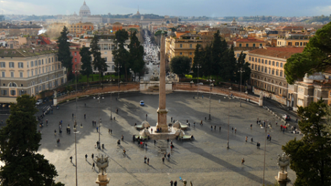
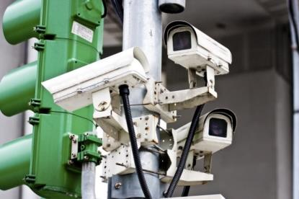
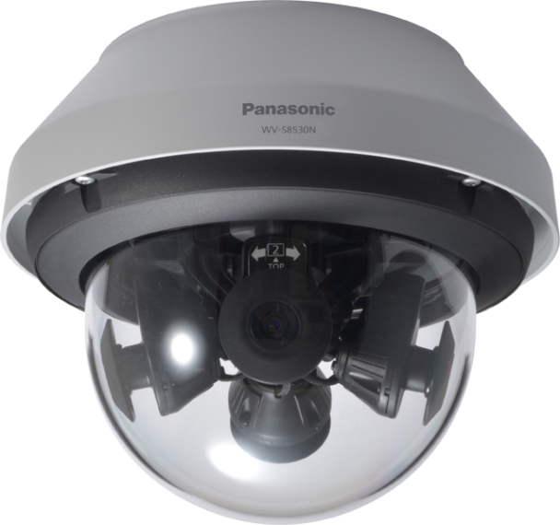

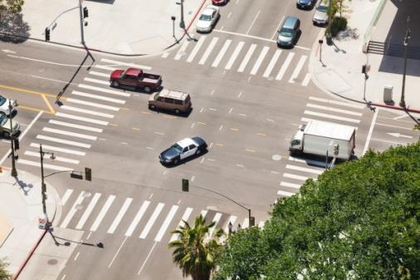
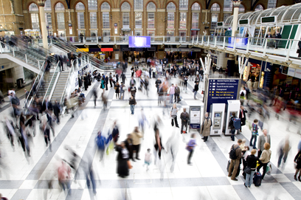
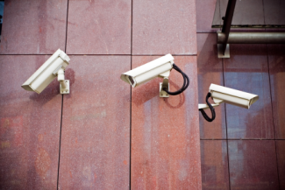
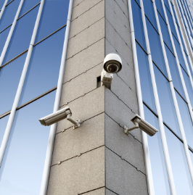
What is multi-sensor camera?
In order to monitor wide area such as parking lot, perimeter of building, intersection, airport, station concourse and more ...
Multi-Sensor camera reduces # of cameras minimizing blind spots
Numerous cameras required
One Cable, One Bracket and One PoE port
2

Slide 3


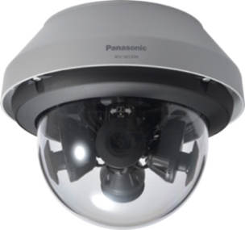


Concept & Main Features
New i-PRO extreme camera with the four repositionable lenses minimize blind spots
and flexibly correspond to wide and variously shaped surveillance areas in cities.
Extreme Visibility
4 x Ture 4K (33MP) high quality resolution (WV-X8570N)
Wide range tilt angle adjustment mechanism minimize blind spots
High sensitivity with color night vision
Intelligent Auto / ClearSight coating
Extreme Compression
H.265 compression with new Smart coding technology
Extreme Data Security
Secure communication with Symantec certification
Extreme Reliability
Vandal resistant / IP66 compliant
Usability
Easy setting
3

Slide 4
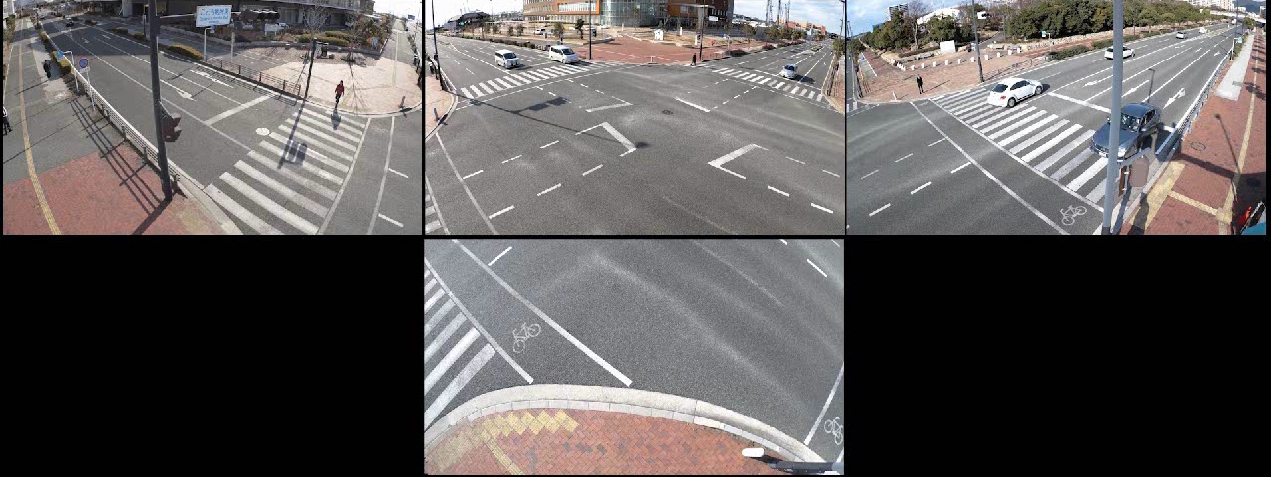

Extreme Visibility
4 x Ture 4K (33MP) high quality resolution
Enables to capture vehicles 100 feet diagonal from intersection corners at three lane streets (WV-X8570N)
4

Slide 5
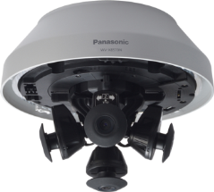
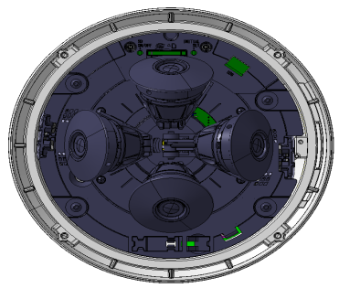
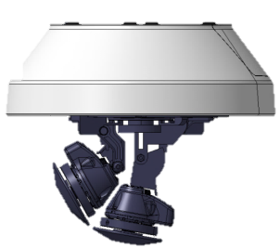

Extreme Visibility
Wide range tilt angle adjustment mechanism
Four repositionable lenses capture objects with minimized blind spots
・PAN angle adjustment
Without fixing screws
・Tilt angle adjustment
Without fixing screws
Cam4 can tilt up to -15 deg.
Cam2
+80°
Cam3
Cam1-3
+30°
・YAW angle adjustment
Without fixing screws
Cam1
Cam4
-15°
0°
Cam4
Various View Angle Modes
360-degree mode / 270-degree + right below mode / 180-degree + right below mode
5

Slide 6
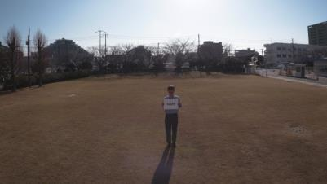
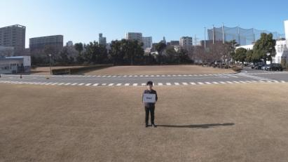
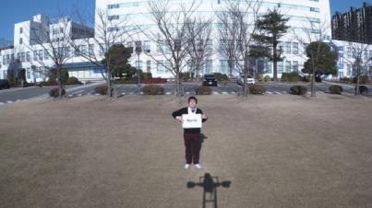
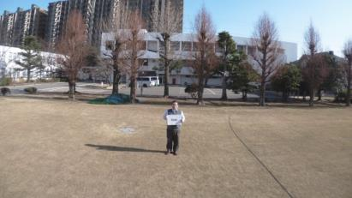
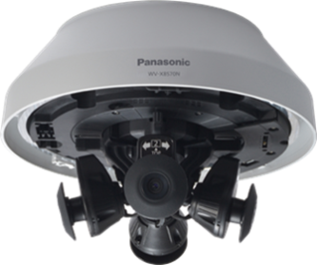
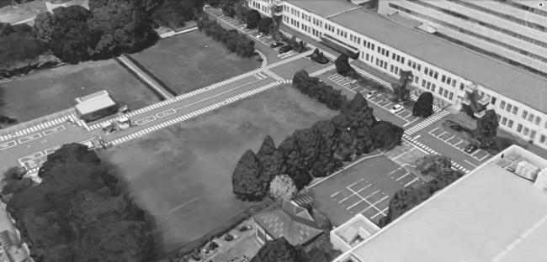

Extreme Visibility
Various View Angle Modes
[360-degree Mode]
One multi-sensor camera covers the whole park area with high resolution images
Cam1
Cam2
Cam3
Cam4
Cam2
Cam3
Cam1
Cam4
6

Slide 7
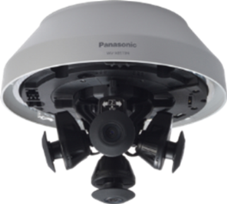
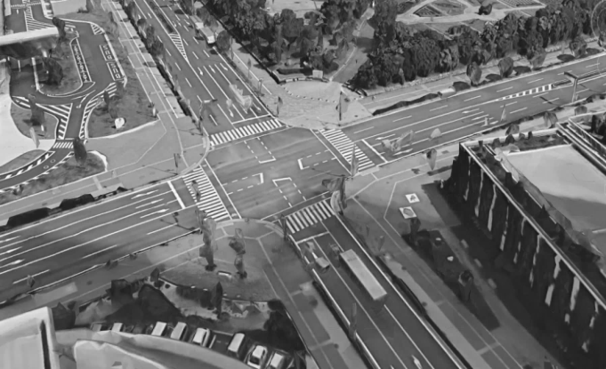
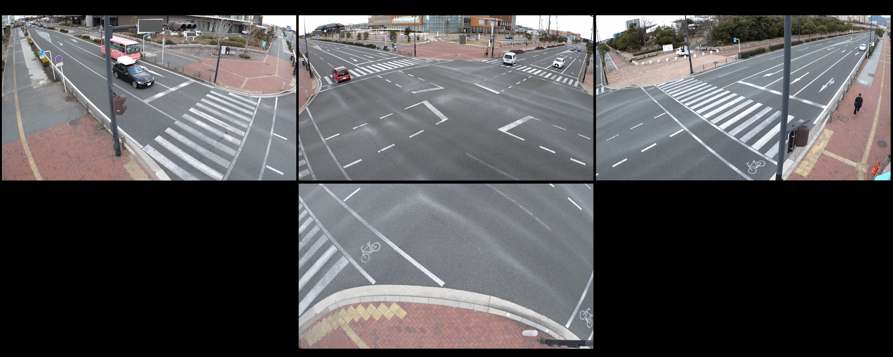

Extreme Visibility
Various View Angle Modes
[270-degree + Right below Mode] At intersection
One multi-sensor camera covers the whole intersection area
including right below of the camera to see all of incidents
Cam3
Cam2
Cam1
Cam2
Cam3
Cam4
Cam1
Cam4
7

Slide 8
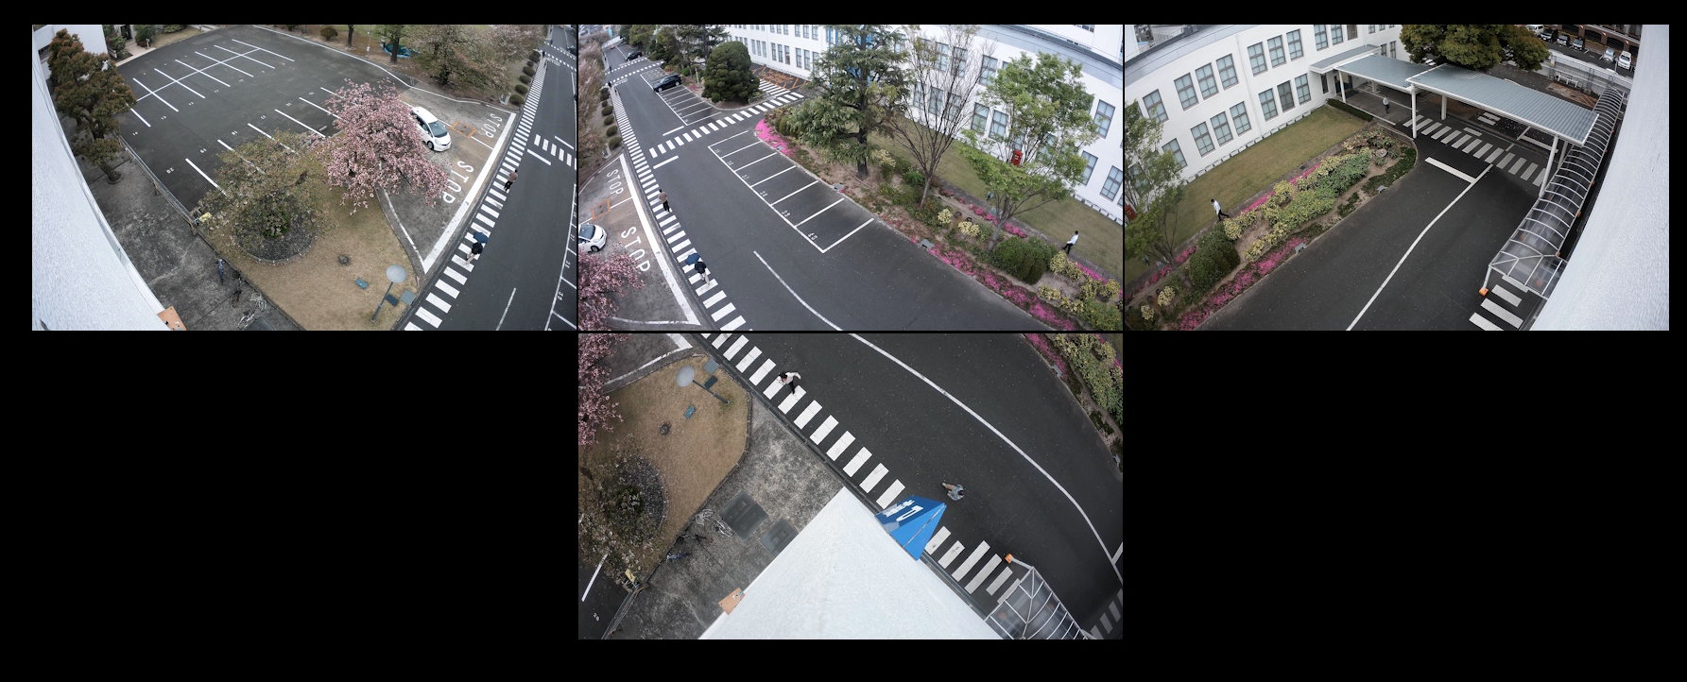
Extreme Visibility
Various View Angle Modes
[270-degree + Right below Mode] At corner of building
One multi-sensor camera overlooks both sides of the building from
the corner at one time.
Cam3
Cam1
Cam2
Cam3
Cam1
Cam4
Cam2
Cam4
8

Slide 9
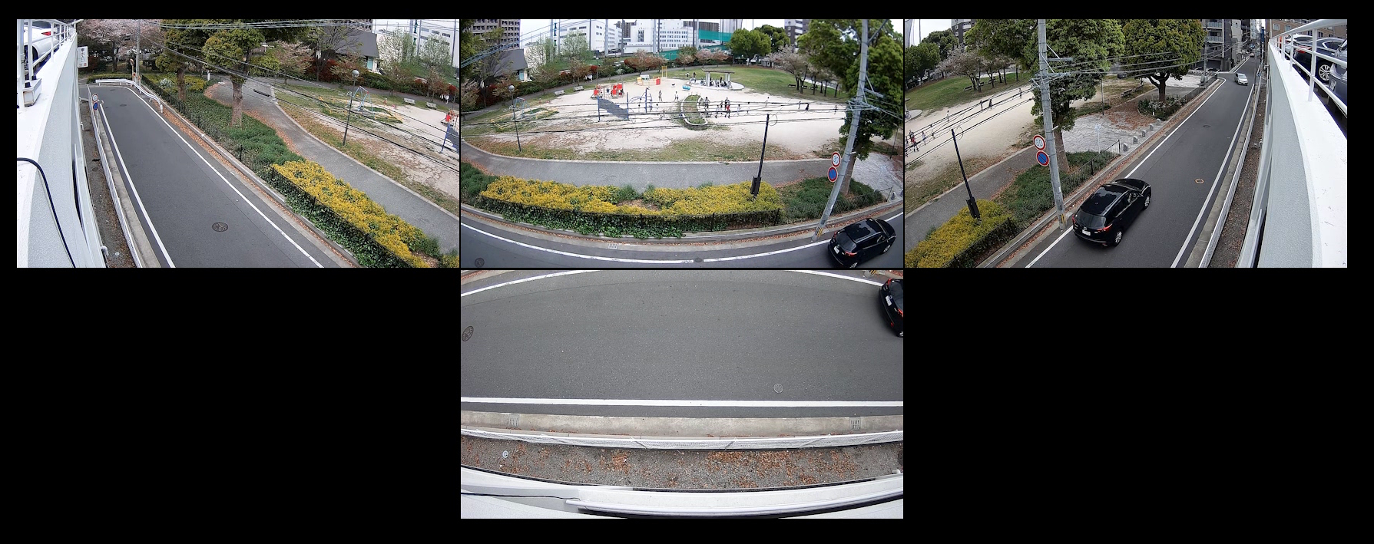
Extreme Visibility
Various View Angle Modes
[180-degree + Right below Mode]
4 x Full-HD multi-sensor camera support 2x zoom lenses and
it’s adjustable to see both directions of road, playfield in front and
sidewalk beside the building.
Cam1
Cam4
Cam1
Cam2
Cam3
Cam3
Cam2
Cam4

Slide 10
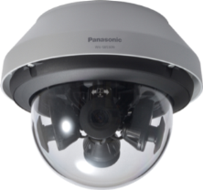
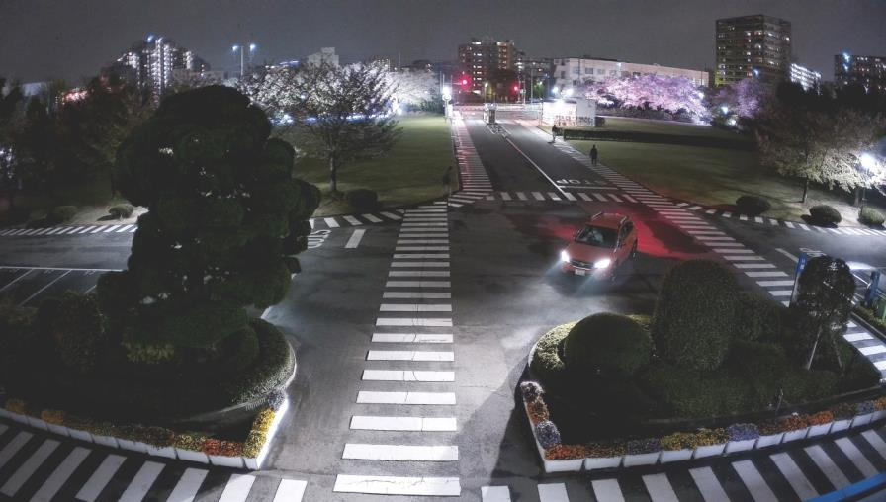
Extreme Visibility
High sensitivity with color night vision
It shows clear color images in low light condition. Vehicle color is more visible even at low light intensity at an intersection.
Multi-sensor camera
WV-X8570N
Under 3 lux lighting environment
10

Slide 11
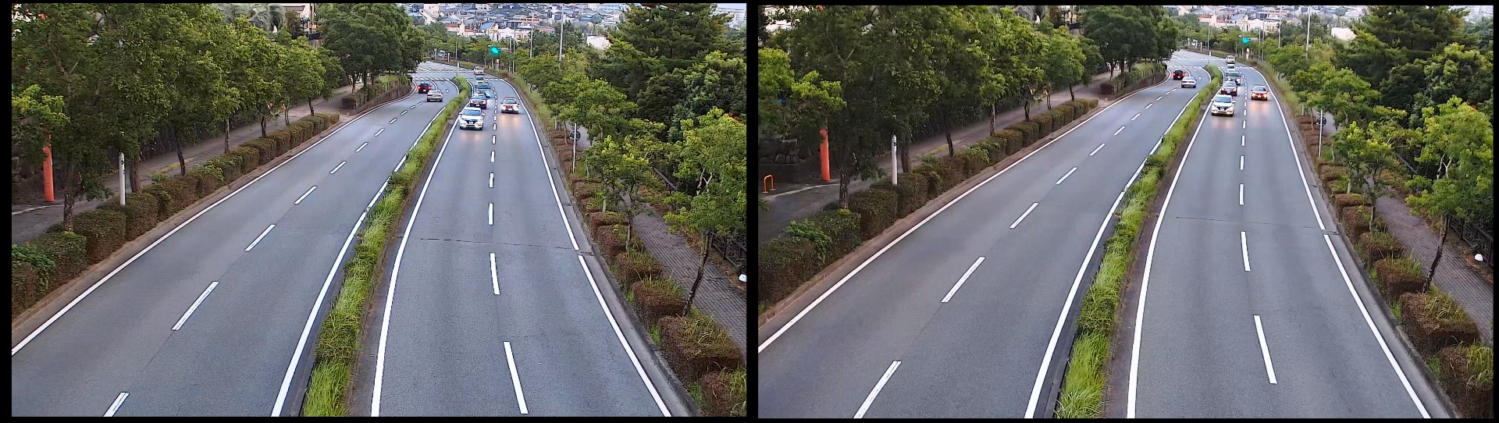
Extreme Visibility
Intelligent Auto
iA-Intelligent Auto monitors scene dynamics and motion to adjust key camera settings automatically in real-time reducing distortion such as motion blur
on moving objects.
Conventional
11

Slide 12

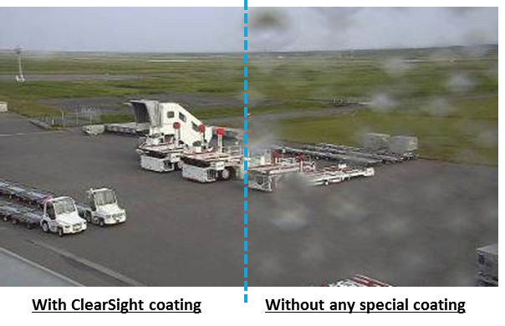
Extreme Visibility
ClearSight coating
The specially coated (ClearSight) dome cover surface resists water stains and dust accumulation, reducing the need for periodic maintenance
12

Slide 13

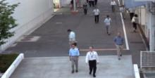
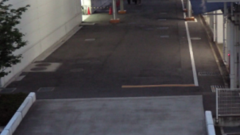
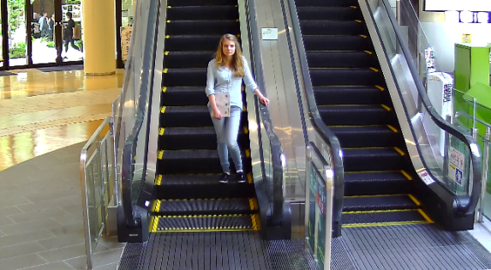









Extreme Compression
H.265 compression with new Smart coding technology
GOP control
Auto-VIQS
Reduces encoding data
by using p-frame in
place of i-frame when
no motion is detected.
WITH MOTION
WITHOUT MOTION
Automatically determine areas with and without motion and reduce the data volume of those without motion.
Low Bit rate
(Higher
Compression)
I-frames are thinned down
to reduce the amount of data.
With
Motion
Without
motion
With
Motion
New
frame rate control
30
fps
15
fps
7.5
fps
3ps
1ps
1ps
*Simulated
image
4
sec
16
sec
32
sec
64
sec
160
sec
480
sec
480
sec
4
sec
Mid. Bitrate (Original compression)
Bit rate reduction
i-PRO extreme
H.265 + Smart coding
H.264
Max.95%
13

Slide 14


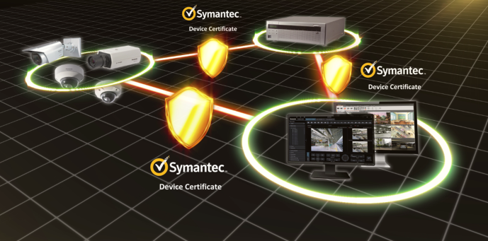






Extreme Data Security
Secure communication with Symantec certification
Vulnerability Assessment
- 3rd party assessment and penetration tests
made to achieve higher security standards
Symantec Device Certification
- Pre-installed Symantec Certification
- Video tampering detection
End-to-End Data Encryption
- Support full encryption communication
- Camera encryption recording on-the-edge
FIPS140-2 Level 1 CAVC compliant
(Federal Information Processing Standardization)
- For federal/public safety usage
14

Slide 15
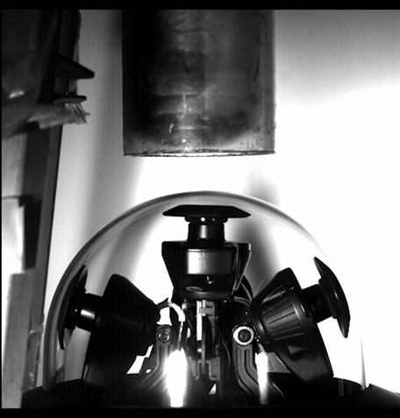
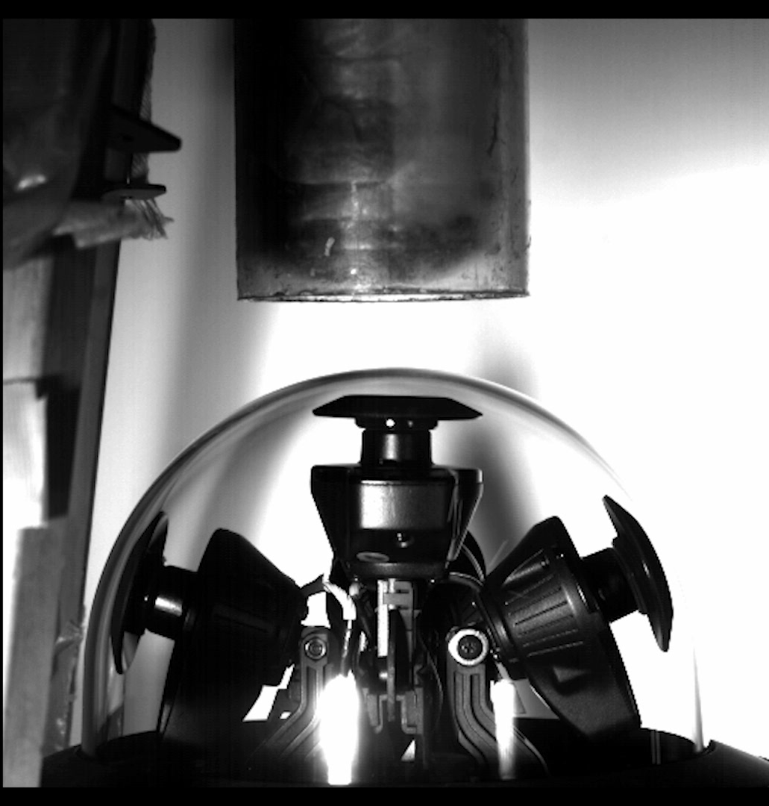
Extreme Reliability
Vandal resistant ( IK10) under challenging environment
Vandal resistant test
15

Slide 16

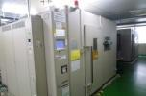
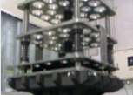
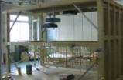


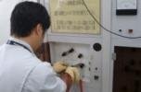



Extreme Reliability
Achieve high endurance and long life usage under extreme conditions
Dustproof Test
High-Temperature Test
Pressure Test
Earthquake Test
Waterproof Test
Lifetime Test
Thunder Test
Static Electricity Test
Drop Test
Box Shaking Test
16

Slide 17
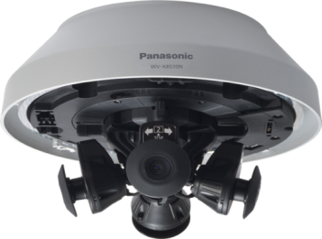
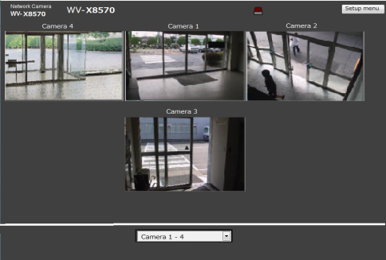





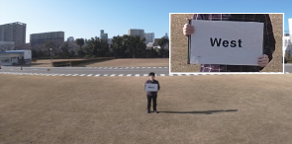
Usability - Easy setting
Installation time can be reduced by confirming live image and adjusting viewing angle with smartphone or tablet device via Wi-Fi connection.
[360 deg. Mode]
[270 deg. + right below mode]
USB Wi-Fi
The single screen will be open when clicking on the live image in multi screen mode.
Insert USB Wi-Fi device* to the USB terminal
on multi-sensor camera
*Purchase compatible USB Wi-Fi device separately.
[Single Screen Mode]

Slide 18
Specifications
 |  | 4 x FHD (8MP) / WV-S8530N | 4 x 4K (33MP) / WV-X8570N
Image sensor |  | 1 / 3” type CMOS | 1 / 1.8” type CMOS
Max. video resolution (pixel) |  | 1920x1080 x 4 cameras | 3840x2160 x 4 cameras
Max. frame rate |  | 30 fps | 15 fps
Video Compression |  | H.264/H.265/MJPEG
Minimum Illumination *Shutter speed 1/30s | Color | 0.09lx @F2.2, 0.006 lx @ shutter speed 16/30 | 0.12lx @F1.6, 0.008 lx @ shutter speed 16/30
 | B/W | 0.04lx @F2.2, 0.003 lx @ shutter speed 16/30 | 0.05lx @F1.6, 0.003 lx @ shutter speed 16/30
Angular Field of View | Horizontal/Vertical | (16:9 mode) 53°-99°/ 30°-54° (4:3 mode) 44°-81°/ 33°-60° | (16:9 mode) 97°/ 53°
Adjusting angle |  | Camera 1/2/3 : Horizontal (PAN) 360°, -Vertical (TILT) +80° to +30 °, Azimuth (YAW) ±50 ° Camera 4 : Horizontal (PAN) 360°, -Vertical (TILT) +80 ° to 0 °(right below) to –15 °Azimuth (YAW) ±50 °
Audio Compression |  | - | G.726, G.711, AAC-LC
SD memory card slot |  | 1slot (SDXC/SDHC/SD)
Zoom Ratio |  | Digital zoom (x1, x2, x4)
Wide dynamic range / Intelligent Auto/Smart coding |  | Super dynamic 108dB / Yes / Yes
Secure communication |  | FIPS 140-2 Level 1 compliant
Environmental |  | IP66 (IEC60529 ), Type 4X(UL50), NEMA 4X compliant, IK10( IEC 62262), ClearSight coating
External I/O Terminals |  | - | AL IN 1 x1 (AL input 1/ B/W input/Auto time adjustment input) AL IN 2 x1 (AL input/output) , AL IN 3 (Al input/AUX output)
Audio input / output |  | - | ø3.5 mm stereo mini jack x 1 / --
Ambient Operating Temperature |  | -40 °C ~ +60 °C (-40 °F ~ 140 °F) *Power On range: –20 °C ~ +60 °C {–4 °F~ 140 °F})
Power/ Dimension (mm) / Mass(approx.) |  | PoE (Approx. 12.95W) / ø230 mm × 196 mm / Approx. 2.8kg (X8570N), 2.7kg(S8530N) * When using attachment plate only
18

Slide 19
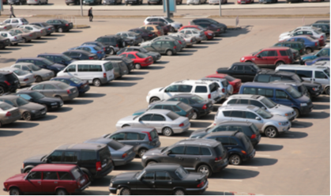


Industry examples
Those cameras are suitable under the extreme conditions
Intersection
Station, Airport
(Concourse, Runway)
Building periphery
Park
Plaza
Parking lot and more.
19

Slide 20


