Slide 1
Network Video Disk Recorder
WJ-NX400 NX400K(AC120V),NX400K/G(AC220-240V)
WJ-HXE400 (Extension unit)
Ver.2.01
Panasonic i-PRO Sensing Solutions Co., Ltd.

Slide 2

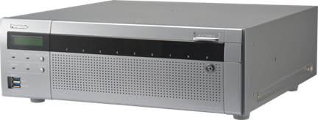
Concept & Main Features
H.265/H.264 high-throughput and scalable recorder featuring integrated GUI and
robust embedded IP security enabling a secure end-to-end PC-Less surveillance solution
Secure & High Compression Recording
PC-Less Surveillance Solution
Up to 128 cameras (H.264/H.265) support
640 Mbps Maximum Total throughput
Secure Communication between cameras and WJ-NX400 and between WJ-NX400 and applications
Dual Stream Recording for narrow band network playback
Easy installation & operation
High speed copy to the USB storage
Built-in GUI and Dual HDMI Outputs
TURBO-RAID Function
TURBO-RAID recording
TURBO-RAID recovery
High Reliability & Redundancy
Eco-writing : Acceleration of data access
Long-life control（HDD stand-by control mode）
Momentary power failure resistance
NAS back up ・ Failover
Vibration proof structure

Slide 3
Secure & High Compression Recording
128 cameras (H.264/H.265)
WJ-NX400 supports up to 128 cameras. As basic recorder, WJ-NX400 support
64 cameras. When adding three additional licenses WJ-NXE40(W) in WJ-NX400, WJ-NX400 supports up to 128 cameras.
In addition, WJ-NX400 can record both H.264 and H.265 stream.
It is easy to configure a coexisting system of i-PRO H.264 cameras and i-PRO H.265 cameras since WJ-NX400 can record both H.264 and H.265 stream.
Add two licenses
(up to 128 cameras)
Add a license
(up to 96 cameras)
NXE40
Additional
Camera
kit
NXE40
Additional
Camera
kit
640 Mbps Total throughput
WJ-NX400 is equipped with maximum 640 Mbps as total throughput. Maximum recording throughput is 384 Mbps, and it is possible to record the images of 128 cameras when connecting Full-HD H.265 camera (30ips, 2 Mbps). Maximum output throughput is 256 Mbps, and the video of 128 all cameras (Full-HD, 30ips, 2M bps) can be output to a monitoring software at one time.
Basic : up to 64 cameras
WJ-NX400
Network Video Disk Recorder

Slide 4

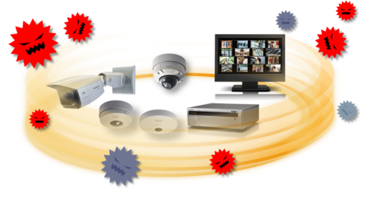

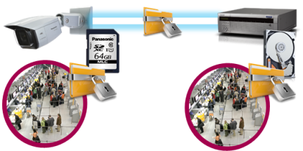


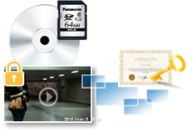
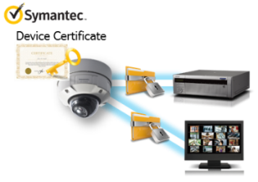
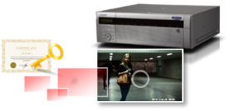
Secure & High Compression Recording
Secure Communication
Protect the devices from cyber attacks
Prevention leakage of the video
Eliminated vulnerability with the latest CVE* support
*CVE : Common Vulnerabilities and Exposures. Common Vulnerabilities and Exposures is a dictionary of common names
(i.e., CVE Identifiers) for publicly known
Panasonic cameras deliver the encrypted video, and it‘s stored in WJ-NX400 (Panasonic recorder).
The data can be password-protected and alteration detection helps ensure credibility of data.
*When using this function, you need optional licenses.
The stream and video are encrypted by the module meet FIPS140-2 level 1 CAVP*. Panasonic fully protect the stream and the video on the End-to-End System.
*Evaluated by WV-TW370P
Prevention leakage of the data
on communication network
Realize secure communication between devices by using communication encryption (SSL/TLS communication).
By using hash value, can detect Video alteration.

Slide 5










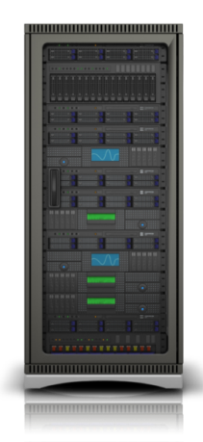
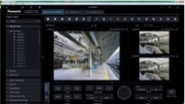

Secure & High Compression Recording
Dual Stream Recording for narrow band network playback
Video delay may be happened as playing a several cameras at one
time or playing on a narrow band. Therefore, WJ-NX400 has
the function which can record 2 stream per a camera.
When using this function, an operator can set the stream
depending on their playback environment.
i.e)
1st stream is recorded at Full-HD resolution and 2nd stream is
recorded at VGA resolution.
・When network band of an operating environment is narrow band.
・When playing the video on WV-ASM300, it plays a video of 1st stream.
・When an operator play a several cameras at one time.
It is possible to use 2nd stream when playing the video on
multiscreen on WV-ASM300.
i-PRO Extreme H.265
i-PRO H.264 cameras
1st stream
2nd stream
1st stream
2nd stream
Rec
Rec
WJ-NX400
Playback
WV-ASM300 series

Slide 6
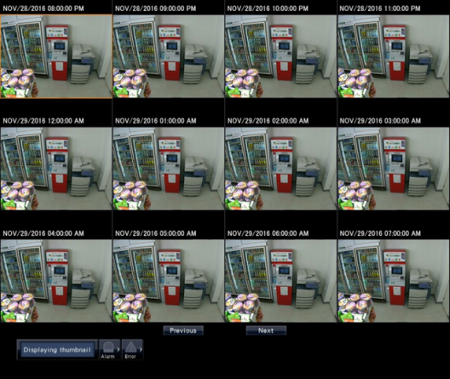
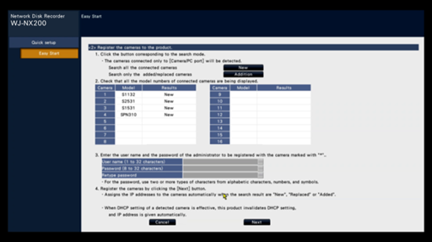
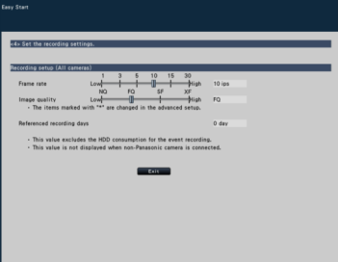
PC-Less Surveillance Solution
Easy installation & operation
・Automatic Security System configuration wizard
・Image search with thumbnail
With only 4-steps “Easy start” of WJ-NX400, the setting of the recorder and cameras is completed in a few minutes from main display (without PC).
Easy to find out image by thumbnail search
Time and date setting
Camera registration
Multi-screen layout setting
Recording image quality setting
[Note]
Multiple cameras are not supported
It is necessary to select start date and time and display interval
Camera registration GUI

Slide 7


PC-Less Surveillance Solution
High speed copy to the USB storage
Data copy speed will be 3 times higher than WJ-NV300
Example
・2 cameras x 48 hours data copy
・ USB3.0
・Smart coding :efficiency of data compression
NV300
Approximately 18.0 Hours
NX400
6.0 Hours
Built-in GUI and Dual HDMI Outputs
Main display (HDMI)
Equipped with two HDMI output, WJ-NX400 provides PC-less operation that enables users operate just about all features from the main display without running a PC. The main and sub displays support multi-screen viewing. The main display supports up to 4K resolution, and the sub display supports up to Full-HD resolution.
Display | Interface | Viewing live images | Playback videos | Operation and Setting
Main display | HDMI | P | P | P
Sub display | HDMI, BNC | P | - | -

Slide 8
TURBO-RAID Function
TURBO-RAID Recording
TURBO-RAID Recovery
Keep throughput performance
Achieve high-speed recovery time
RAID of WJ-NX400 equipped with Turbo-RAID keeps it the same as non RAID configuration. An additional unit by the reduced performance isn't needed. Turbo-RAID can provide the ensuring reliability of data and the high-performance throughput.
If a recorder needs to recover for crashing the data, it is possible to recover in a short time.
WJ-NX400 equipped with Turbo-RAID can be recovered in half the time more than a general network recorder when recording mode is on.
Non-RAID
Recording rate performance
Leading brand
NVR RAID
Leading brand
NVR RAID
performance
-50%
1/2 hours
Panasonic
Turbo-RAID
Panasonic
Turbo-RAID
Recovery Time
*Compare with ordinary NVR
performance
100%

Slide 9
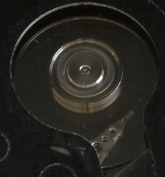
High Reliability and Redundancy
Eco-writing : Acceleration of data access (reading/writing) by original filesystem
Reduce the movement of a head to the utmost limit
Reduce the movement of a head to the utmost limit
WJ-NX400 can reduce the movement of a head to the utmost limit to access own HDD since it equips with Panasonic proprietary file system. Thus WJ-NX400 achieves the high efficiency of writing control, and can extend the life of HDDs.
Reduce fever of actuator motor
Reduce abrasion of motor
NX300

Slide 10

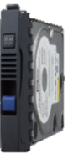
High Reliability and Redundancy
Long-life control - HDD stand-by control individually
WJ-NX400 can manage the status of each HDD using three state.
1st is the active state which is ready accessed by WJ-NX400 to a HDD.
2nd is the idle state, it indicates the status which is ready for next access.
3rd is the stand-by state, it indicates the state stopping a motor.
Reduce
a HDD operation time
Management of HDD in a WJ-NX400
In the case of the RAID configuration
Active
idle
Stand-by
Activating only when access to HDD is required.

Slide 11
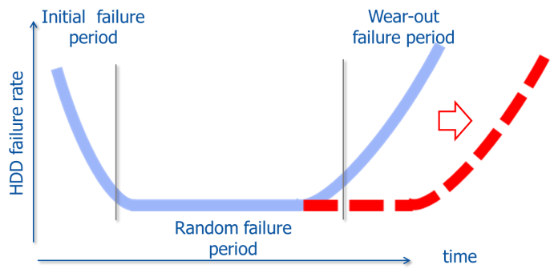
High Reliability and Redundancy
Long-life control - Reduce the movement of a head to the utmost limit
WJ-NX400 can reduce the movement of a head to the utmost limit to access own HDD since it equips with Panasonic proprietary file system. Thus WJ-NX400 achieves the high efficiency of writing control, and can extend the life(it is not extend HDD operating time) of HDDs.
(Usage period)

Slide 12
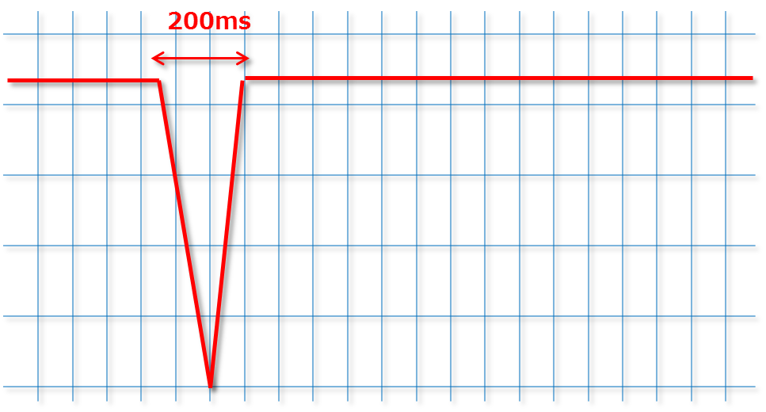
High Reliability and Redundancy
Momentary power failure resistance
“Keep working & recording” without UPS
WJ-NX400 doesn’t have UPS, but it doesn’t stop and doesn’t reboot even when occur a instantaneous voltage drop within 200ms.
When a power failure time is longer than 200ms, WJ-NX400 detects a power interruption and shuts safe down by itself. WJ-NX400 provide a stable recording and a stable operation for you.
Salvable
momentary power failure
95%
*This is an electric power condition of late Japan.

Slide 13








High Reliability and Redundancy
NAS back up
WJ-NX400 supports to backup important data to NAS devices.
NAS ① Drive A
NAS ①
WJ-NX400①
NAS ①
WJ-NX400
WJ-NX400
Drive A
for NVR ①
Drive A
Drive B
Drive B
for NVR ②
NAS ② Drive A
WJ-NX400②
Back up to two NAS devices
Back up to two HDD drives
in a NAS devices
Data in two NVRs back up to
two HDD drives in a NAS devices
Two type of back up setting
・Continuous back up : Specify back up starting time in everyday
・Schedule back up : Specify back up time period(start to stop)

Slide 14




High Reliability and Redundancy
Failover
Redundant fail-over using 2nd recorder to enable mission-critical recording
Recording WJ-NX400
Standby WJ-NX400
Up to 5 units
Monitoring
the operation status
Detect failure unit
Standby recorder will be started to record instead of failure one

Slide 15
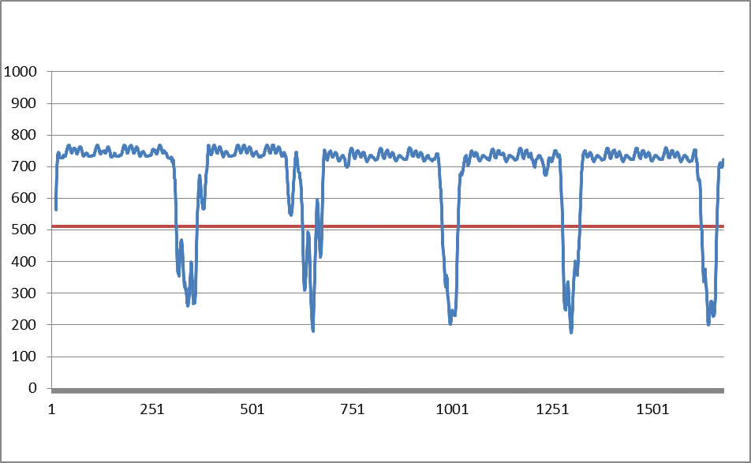
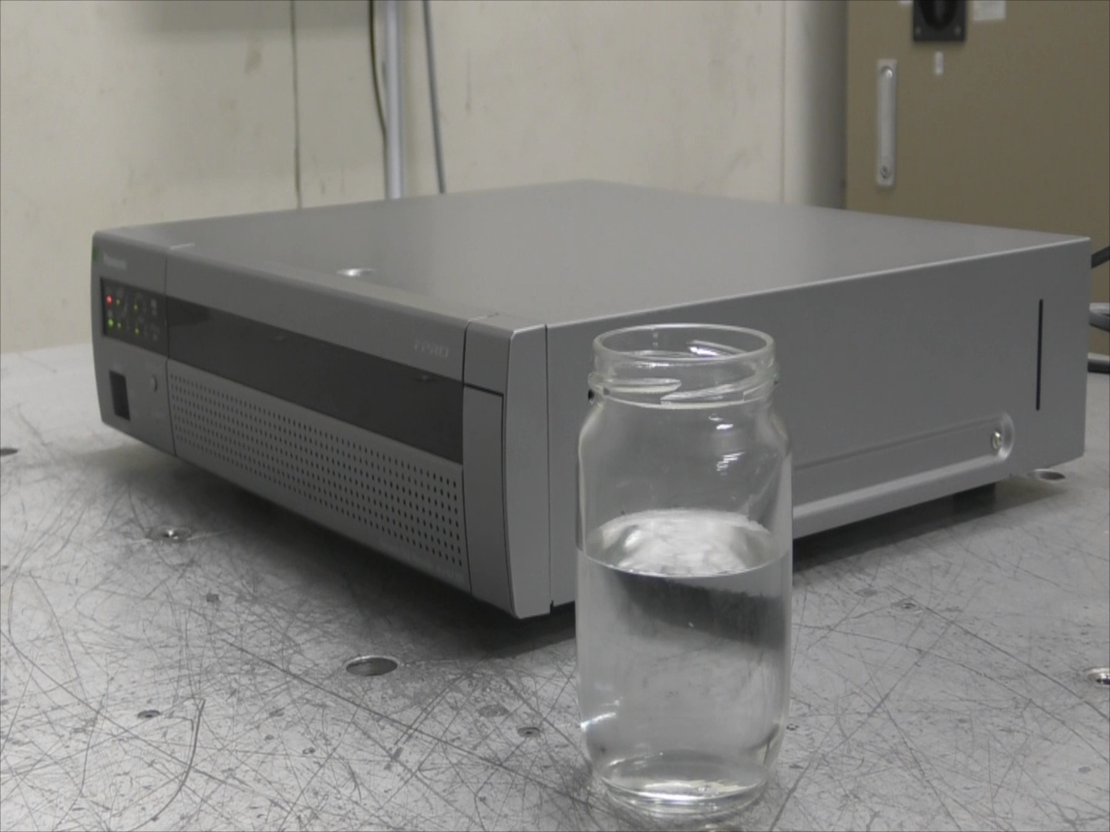
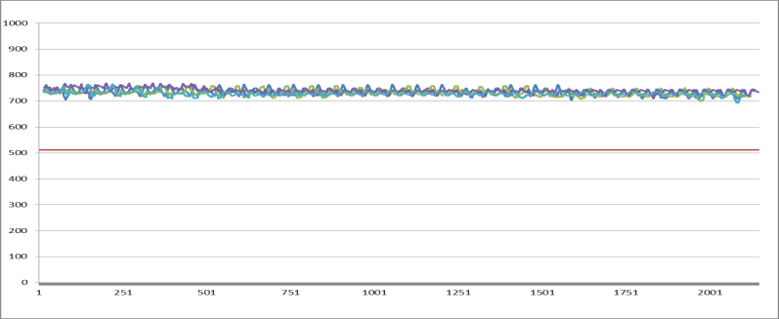
High Reliability and Redundancy
Vibration proof structure
Keep recording even in a vibrating environment like blower and compressor vibration
Leading brand NVR
Vibration test : Vibration frequency 5 Hz-100 Hz in 5 minutes period
Transfer rate
Ex. WJ-NX300
*NX series NVR are used same structure
Transfer rate
*Photo is WJ-NX300 for reference
It enables to stable recording even when receiving vibration from surrounding environment such as air conditioner, walking if NVR on the desk
Number of writes to a HDD in 5 minutes

Slide 16





Others – Useful Features
Camera Group Recording
Camera group recording function allows to set saving period of recorded image for each camera
group at each installation locations.
(Example)
Area (A)
Recording for area(A) : Saving period 180days
Camera 1
Camera 20
Set up 2 camera group
HDD1
HDD2
HDD3
HDD4
HDD5
HDD6
Area (B)
WJ-NX400
Camera
21
Camera
22
Camera
64
HDD7
HDD8
HDD9
Recording for area(B) : Saving period 30days

Slide 17

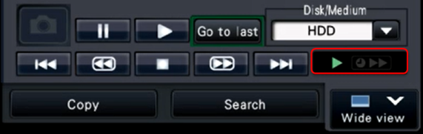

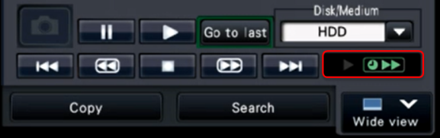

Others – Useful Features
Time-saving playback
Playback time can be saved by high speed playback when there is no movement during playback mode.
In case of recorded image is played back on up to 4 screen
Status indication
1x speed playback
During there is movement
i-PRO cameras
Time-saving playback During there is no movement
NW
Single screen : 4x playback
2/3/4 screen : 2x playback
WJ-NX400

Slide 18

Others – Useful Features
MP4 Download
WJ-NX400 built in MP4 download function to USB storage media for video and audio data.
Download
WJ-NX400
 | Recording Condition
 | Video | Audio
1 | H.264/H.265 | AAC-LC
2 | H.264/H.265 | G.726/G.711 360-degree microphone
3 | JPEG/MPEG | N/A
 | MP4 Output result
1 | Video and Audio
2 | Video only
3 | Error

Slide 19
Others – Useful Features
Corridor mode
Corridor mode enables the capture of a more vertically-oriented on several screen layout
2-screen layout
3-screen layout
4-screen layout
1 | 2
1 | 2 | 3
1 | 2 | 3 | 4
(960x1080)
(640x1080)
(480x1080)
5-screen layout
6-screen layout
7-screen layout
1 | 2 | 3
 |  | 4
 |  | 5
1 | 2 | 3 | 4
 |  |  | 5
 |  |  | 6
1 | 4 | 5
2 |  | 6
3 |  | 7
(640x360)
(480x360)
(640x360)
(640x360)
(640x1080)
(480x1080)
(640x1080)

Slide 20







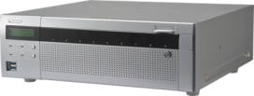







System Configuration
ASM300
Monitor output
(up to 128 cameras)
Mobile
HXE400
NX400
Software license
NW
NXE40
Additional
Camera kit
NXSxx
Secure
Comm.
kit
Basic up to 64 cameras
NW camera
Key-board
Mouse
Coax-Lan convertor
Analog camera
Encoder
Decoder
Monitor

Slide 21
WJ-NX400 Specifications
Supported Cameras | Supported Image Format | H.265,H.264,JPEG,
 | Supported Audio Format | G.726 32kbps, G.711 64kbps (For ONVIF camera), AAC-LC
 | Maximum Number of Cameras | MAX.128
Recording | Recording Mode | Event, Schedule, Emergency
 | Frame Rate/Camera | Up to 60 ips
 | Others | Pre-Event Recording, 2 stream recording
HDD | Type | 3.5 inch Serial ATA HDD, Up to 9x HDDs can be installed
 | Maximum Capacity | 54 HDD slots (with 5x WJ-HXE400 Extension Units, 9x HDDs installed in each unit) Up to 6TB is supported
 | RAID(Hardware RAID) | RAID 1 / 5 / 6
Network | Interface | 2x 10BASE-T / 100BASE-TX / 1000BASE-T (RJ45)
 | Maximum Band Width | Total throughput : Max. 640Mbps Recording throughput : Max. 384Mbps, Output throughput : Max. 256Mbps
External Interface | Spot Output Connector/Audio output | 1x 1 V [p-p] / 75 (BNC), −10 dBv, 600 , 600 , unbalanced ×1 (RCA pin jack)
 | Monitor (HDMI) Connector | [Main monitor] HDMI 4K UHD(3840x2160p) /30Hz, 4K UHD(3840x2160p) /25Hz, 1920x1080p /60Hz, 1920x1080p /50Hz, 1920x1080i /60Hz, 1920x1080i /50Hz [Sub monitor] HDMI 1920x1080p /60Hz, 1920x1080p /50Hz, 1920x1080i /60Hz,1920x1080i /50Hz
 | Alarm Connector | Alarm input: 32 / Alarm output:4 / Alarm reset:1/Error output:7 / Control etc.:4
 | External Storage | Only for WJ-HXE400 Extension Unit
 | USB connector | Front x2: USB3.0 x1 (copy), USB2.0 x1(mouse, keyboard), Rear x2: USB3.0 x1 (copy), USB2.0 x1(mouse, keyboard)
General Specifications | Power Source/Power Consumption | WJ-NX400K : 120 V AC 60 Hz / WJ-NX400K/G : 220 V - 240 V AC 50 Hz/60 Hz, Approx. 125 W (with 6 TB HDD x9)
 | Ambient Operating Temperature | +5 °C to +45 °C (41 °F to 113 °F)
 | Ambient Operating Humidity | 5 % to 90 % (no condensation)
 | Dimensions (W x H x D) | 430 mm x 132 mm x 413 mm (16-15/16" x 5-3/16" x 16-1/4“, excluding rubber feet and projections)
 | Weight | Approx.11.5kg (25.4lbs) [without HDD] / Approx.20.0kg (44.1 lbs.) [with 9x 6TB HDDs]

Slide 22
WJ-NX400 Specifications
 | NX400
 | Standard (No camera additional kit) | with camera additional kits
Compression | H.265,H.265,JPEG
Max. number of CH | 1-64CH | 65-96CH (1 kit) 97-128CH (2 kits)
Through put in | 384Mbps
Through put out | 256Mbps
Num. HDD | 9
Raid | 1,5,6
Extension unit | HXE400x5
Monitor out | HDMIx2 | NO
Transcode | 2 user access | NO
Sub-stream Rec. | Yes (Full CH) | NO
NAS back up | YES
Face recognition | NO
Failover between NVRs | YES
HDD stand-by control mode | YES
Copy port/(USB port num.) | USB/(4)
Dimensions | 430x 132x 413 mm
Easy Installation | Yes
RJ45 port (rear side) | 2
RJ45 maintenance port (front side) | 1

Slide 23

WJ-NX400 optional line-up
Software
Additional Camera kit | WJ-NXE40(W) | Additional channel license(Up to two license for 128 cameras)
Secure Communication license | WJ-NXS128(W) | Secure optional license for 128ch
 | WJ-NXS16(W) | Secure optional license for 16ch
 | WJ-NXS04(W) | Secure optional license for 4ch
 | WJ-NXS01(W) | Secure optional license for 1ch
Hardware
Model | WJ-HXE400 Extension unit | WJ-HXE400/G Extension unit
Power Source | 120 V AC, 60 Hz | 220 - 240 V AC, 50Hz / 60Hz
Power Consumption | 85 W (170 VA) | 85 W (175 VA)
Dimensions (W x H x D) | 430 mm (W) x 132 mm (H) x 413 mm (D) (16-15/16” (W) x 5-3/16” (H) x16-1/4" (D)) (excluding rubber feet and projections)
Weight | 11 kg {24.3 lbs} (When no HDD exist) 19.5 kg {43.0 lbs} (When 9 HDDs are installed)

Slide 24





Applications
This recorder is suitable under the extreme conditions :
Public safety
Transportation
(Airport/Train/Subway)
Banks
Retails
Hospitals
Education
Factories and more.

