Slide 1
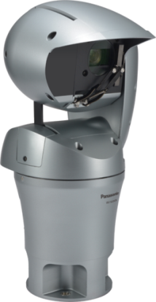
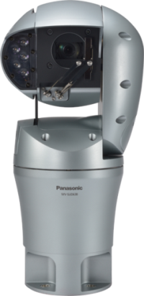

Aero PTZ camera
WV-SUD638
Ver. 1.21
Panasonic i-PRO Sensing Solutions Co., Ltd.

Slide 2

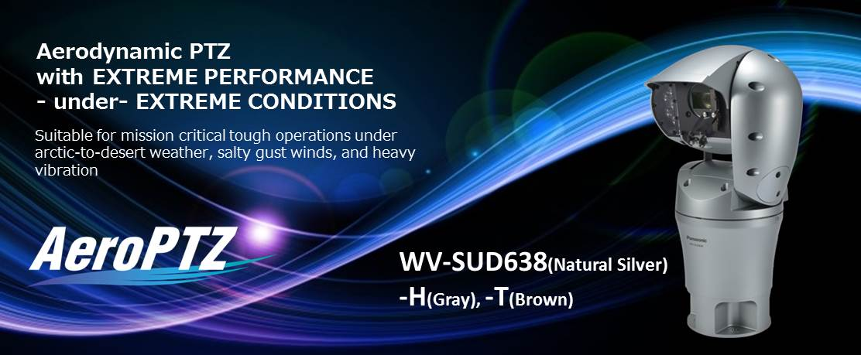
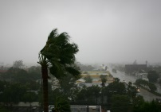

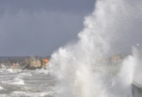
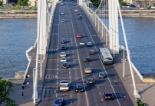
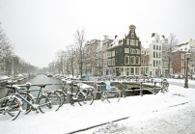
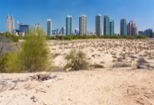

Slide 3
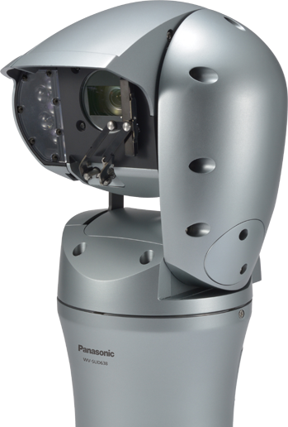
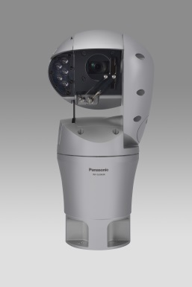
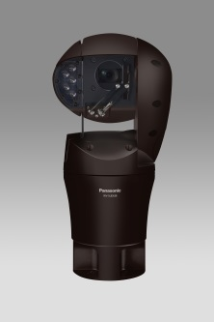

AeroPTZ
Can install this camera in any extreme conditions
Can capture clear images with extreme performance
The Aero PTZ camera continues to function even during hurricanes and typhoons of wind speeds up to 216km/h (135 mph). And, the camera is not damaged by winds up to 288km/h (180 mph).
The Aero PTZ camera is rated to ISO14993 and is equipped with a body which can be captured in heavy-salt damage place, a glass fiber reinforced plastics body.
The Aero PTZ camera support IP67- and IP66-rated weather resistant.
The Aero PTZ camera is equipped with defroster and continues to function in extremely cold (-50° Celsius) and extremely hot (+60° Celsius) environments.
In order to capture stable images, Hybrid image stabilizer (Video SAS technology) reduces vibrations when large vehicles pass and swaying on top of bridges.
The Wiper & Washer of the Aero PTZ camera removes water and dirt that may blur image.
The Aero PTZ camera is equipped with IR LED (optional), and can capture more clear images up to 150m (500feet) ahead.
Silver
Gray
Brown

Slide 4
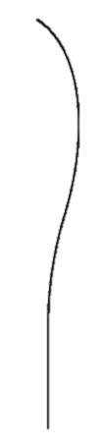
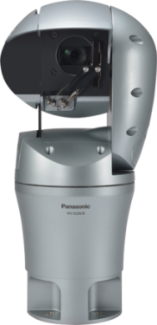
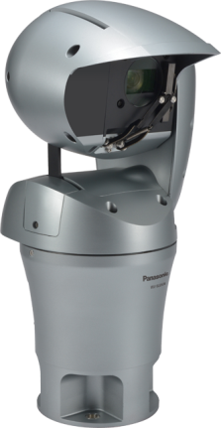
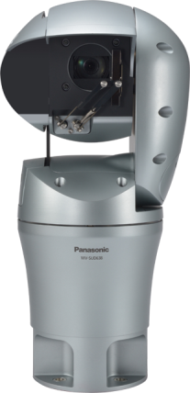
Can install this camera in any extreme conditions
Wind-resistant
Heavy-salt damage-resistant
Can operate under strong wind
Can monitor images at the salt air place
The Aero PTZ camera has 360-deg aerodynamic spherical form, and continues to function even during hurricanes and typhoons of violent wind like being fallen a tree (wind speed : approx. 180km/h) and a steel tower might bend (wind speed : approx. 216km/h, 135mph).
*Durability of bending style is 180km/h (111mph)
And, even if the wind blows stronger than typhoons, up to 288km/h (180mph), the camera is not damaged.
The Aero PTZ camera is rated to ISO14993 and is equipped with a body which can be captured in heavy-salt damage place, a glass fiber reinforce plastics body.
In addition, the camera is equipped with the anti-salt material such as the corrosion-resistant screws, the borosilicate glass and the die-cast part painted.
Glass fiber reinforce plastics body
Borosilicate glass
Corrosion-resistant screws
Die-cast part is anti-salt painted
Glass fiber reinforced plastics body
In addition, It is less likely to the fixing of the screw due to corrosion for the camera use the corrosion-resistant screw to screw which is exposed to the outside.

Slide 5


Can install this camera in any extreme conditions
Note : What is the specification of heavy-salt damage-resistant?
Heavy-salt damage-resistant
Salt damage-resistant
salt air
salt air
Less than 300 m (984feet)
300 m to 1 km
(984 feet to 3,280 feet)
Important：
Please pay attention to the installing location of this camera, such as installed in a location that seawater spray doesn’t splash directly.
When installing this camera at a location which is a coastal region and rainwater doesn’t splash directly, please wash out with water or clean it regularly for removing the salt adhered to the camera.

Slide 6


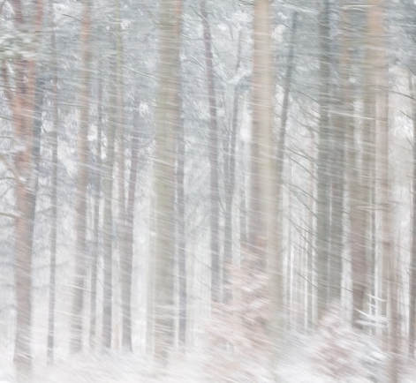

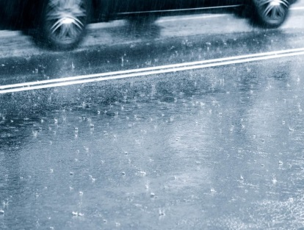
Can install this camera in any extreme conditions
Heat- and Cold-resistant
Waterproof
Can monitor images under severe temperature conditions
Can install under heavy rainfall and flood
The Aero PTZ camera continues to function in extremely cold (-50° Celsius) and extremely hot (+60° Celsius) environments. Even when installing the camera at extreme cold environment, the front glass of the camera is not frozen by the defroster.
*When the color of camera is Gray / Brown : -50° - +55° Celsius
The Aero PTZ camera supports IP66-rated weather resistant, so that the camera continue to function under heavy rainfall without water entered.
In addition, the camera is equipped with IP67-rated weather resistant. Even if the camera is flooded, the water doesn’t enter in the camera.
*Panasonic tested the camera based on the IP67-standard.

Slide 7
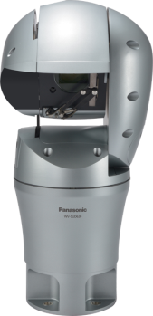
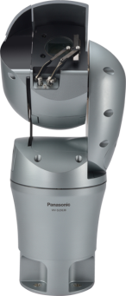
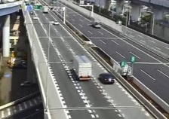
Can capture clear images with extreme performance
Efficient monitoring as reducing vibration
Watch clear images under heavy rainfall
The Aero PTZ camera is equipped with Hybrid image stabilizer function, and reduces the various vibrations and stream stable images even if the camera is installed under strong wind and the place which has plenty of vibration.
*Hybrid image stabilizer : Correcting a slow and large vibration by the motor of Pan and Tilt, and correcting shorter cycle vibration by electronic image stabilizer.
The Aero PTZ camera has Wiper & Washer, it removes water and dirt that blur image since it moves parallel in front of lens, and it can capture clear images. The 360-deg aerodynamic spherical form of this camera decreases snow and dust accumulation.
Up ⇔ Down
Right ⇔ Left

Slide 8
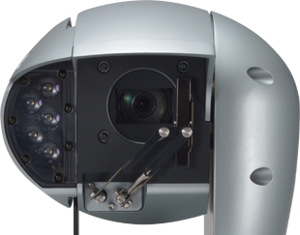
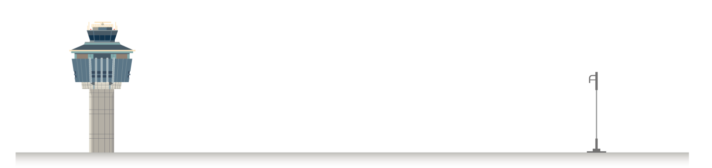
Can capture clear images with extreme performance
Clear images with low light or complete darkness
Equipped with F1.6 - 4.7 diameter lens and high-sensitive sensor, the camera produce a color image with a minimum illumination of 0.06 lux.
And, when equipped with IR LED (optional), the camera can capture more clear images up to 150m (500feet) ahead.
Up to 150m
Aero dynamic spherical form

Slide 9
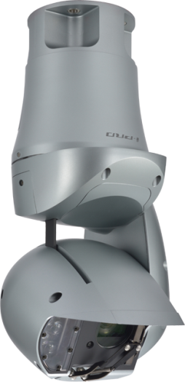
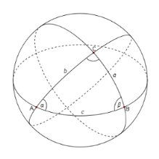
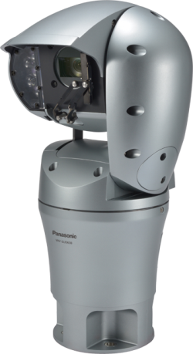
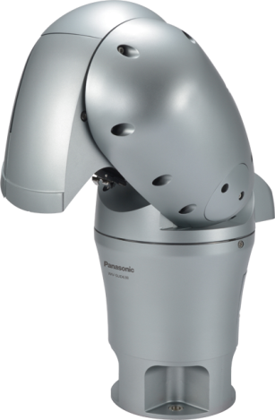
Easy adjust the direction of the camera
When using the 360-degree endless pan and tilt which are provided by “Sphere P/T”, it selects no place to install since the Aero PTZ camera can easily be adjusted the direction of the lens. The camera can be installed on the desktop and ceiling. When being installed on the desktop, it is also possible to monitor directly below.
360-deg
up 30°
Sphere view
Just above
45-deg
Just below
Angle of 45-deg
360-deg
360-deg
Just
under

Slide 10






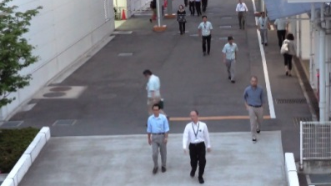
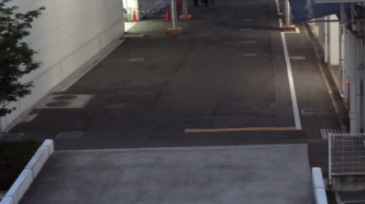
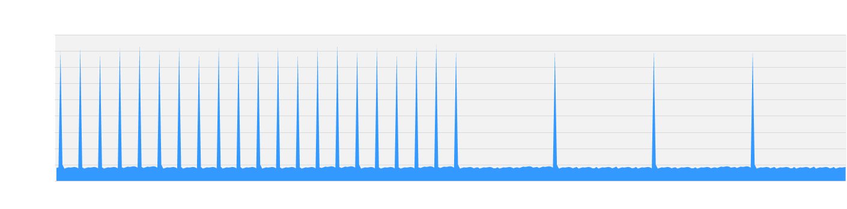
IP-Network friendly
Appropriate-sized video stream
Monitors, recorders, smartphones and remote sites such as branches have different requirements for image quality and network bandwidth. The Aero PTZ camera saves the network bandwidth, sending out up to four H.264 (High profile) streams and JPEG streams sized appropriately for each device requirement.
Higher H.264 compression
With the latest LSI, the Aero PTZ camera saves the network bandwidth and the recorder disk space, keeping high quality of images.
Smart coding Technology
Group of Pictures (GOP) control removes unnecessary information from the frame for realizing efficient encoding.
With the latest bitrate reducing technology, GOP control and 3D-MNR, the Aero PTZ camera saves the network bandwidth and the recorder disk space.
mobile
Monitors
QVGA
recorder
H D
Full HD
Full HD
Cameras | WV-SW598 (Smart Coding : OFF) | WV-SUD638
Full HD at 30fps | 4 Mbps | 3 Mbps ( -25%)
Full HD at 10fps | 4 Mbps | 2 Mbps ( -50%)
Scene | Without GOP | With GOP
Heavy traffic of people | 3 Mbps | 3 Mbps
Minimal traffic of people | 2 Mbps | 1 Mbps(-50 to - 60%)
Generated
code amount
Predicted
Frame
Predicted
Frame
Predicted
Frame
When people are walking, I-frame is inserted at regular intervals as usual.
When there is no person walking, I-frames are thinned down to reduce the amount of data.

Slide 11
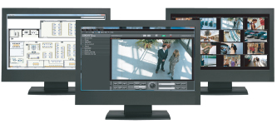
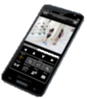
… and other useful features
Central management
The WV-ASM200 and System970 i-PRO management software enables central management of the cameras, recorders and monitors.
Viewing on smartphones and tablets
Panasonic Security Viewer enables viewing outside the surveillance center.
Alarm notification
When VMD, advanced auto tracking alarm, terminal alarm such as door alarm or command alarm is detected, the camera sends alarms to the operators based on pre-configured alert rule and/or saves images to FTP server.
Privacy masking
The camera supports electronic privacy masking. Zones, the masked areas of the image, are easily defined.

Slide 12

Specifications
WV-SUD638
Resolution |  | 1080p | Image stabilization | Hybrid IS
Zoom magnification |  | 30x(4.3～129) | Dust and waterproof | IP67
Min. illuminance (color) |  | 0.06lx | Salt-Resistant | Yes (ISO14993)
F value of lens |  | F1.6～4.7 | Wiper | Yes
PAN | Range | Endless | Power supply | AC100V - 240V
 | Speed | 200 deg/sec | Audio | Yes
TILT | Range | Upright : -45° to +90° Forward : -90° to +90° Hanging : -30° to +90° | Installation Method | Stationary/Hanging
 | Speed | 200 deg/sec | Others | Defroster, IK10
IR-LED |  | IR (Optional) 150m | Weight | Approx. 8kg
Wind speed resistance | Operational | 60 m/s | Temperature | Silver:-50℃ - +60 ℃ Gray/ Brown : -50℃ - +55 ℃
 | Nondestructive | 80 m/s
Silver
Gray
Brown

Slide 13
Applications
AeroPTZ Cameras are suitable under the extreme conditions :
Port
Airport
Railway
Traffic
Safe city and more.

